Slide 1
Open source tools for logic synthesis and SOC Design: An overview
Varun Mohan
Mtech Embedded Systems
National Institute of Electronics And IT

Slide 2
About me
CS graduate
Currently pursuing Mtech in embedded system @ NIELIT Calicut.
Passionate About RTL|Digital Design and FPGA based systems and accelerators.
Other fields of interest
  Bare Metal C Programming | HW/SW CO Design | Computer Architecture

Slide 3
Agenda
Open source tools for logic synthesis
  Functional verification of digital design
  Synthesis and Mapping
  Gate Level Simulation
  Demo : Generating bitstream for an FPGA using a open source flow
Litex
  How to install litex
  How to run your first simulation with microwatt with litex.

Slide 4
Functional Verification
Simulation
  Simulation is the process of checking whether the design is adhering to the given specs. The tool used for simulating the design is called a simulator.
Inputs to the simulator
  The Design.
  The Testbench.
Tool Used
  iverilog

Slide 5
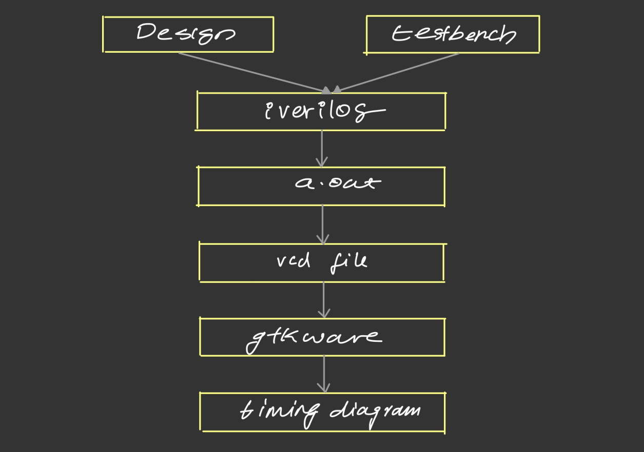
Functional Verification - iverilog flow

Slide 6
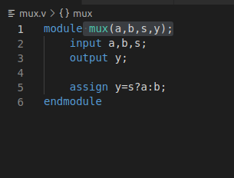
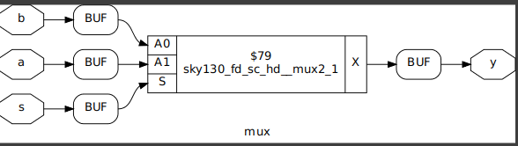
Logic Synthesis - What is it.?

Slide 7
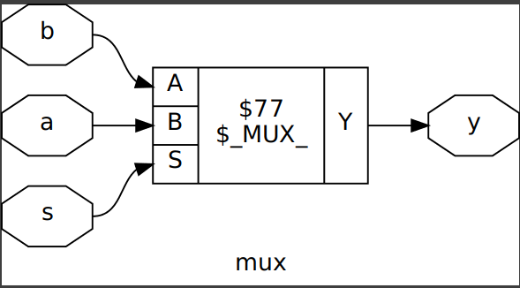
Logic Synthesis - Translation

Slide 8
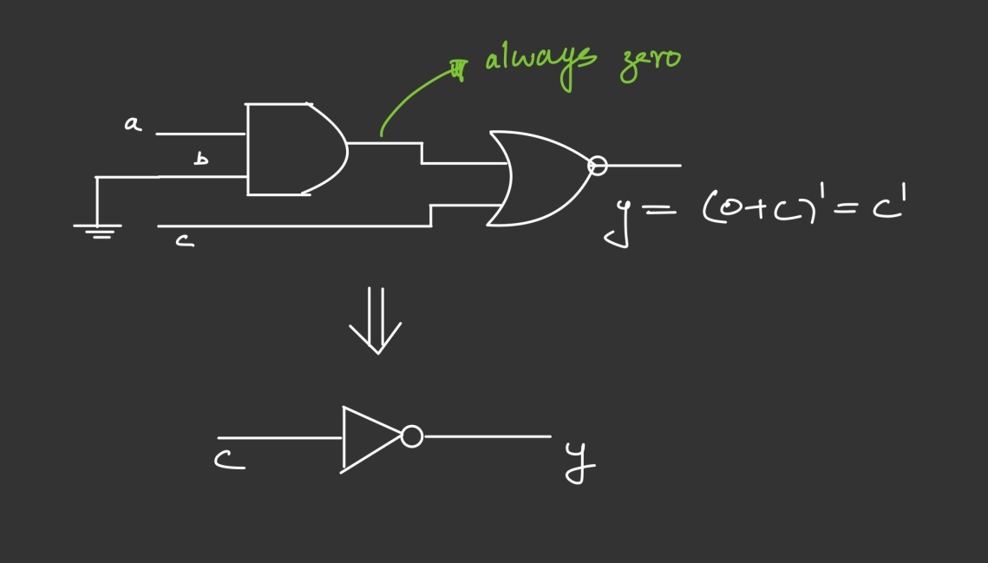
Logic Synthesis - Optimisations

Slide 9
Logic Synthesis - Mapping
The standard cell library
  A standard cell library is a collection of characterized logic gates that can be used to implement digital circuits. This is usually part of set of file created by the foundry called the PDK(Process Development Kit).
  Has many type of files including the timing/power liberty file.
  The SkyWater Open Source PDK
    The SkyWater Open Source PDK is a collaboration between Google and SkyWater Technology Foundry to provide a fully open source Process Design Kit and related resources, which can be used to create manufacturable designs at SkyWater’s facility.

Slide 10
Gate Level Simulation
Why GLS
  check the correctness of the design after synthesis
Synthesis Simulations Mismatches
  Missing signals in sensitivity list
  Blocking and Nonblocking statements
  Missing statements in if|case blocks

Slide 11
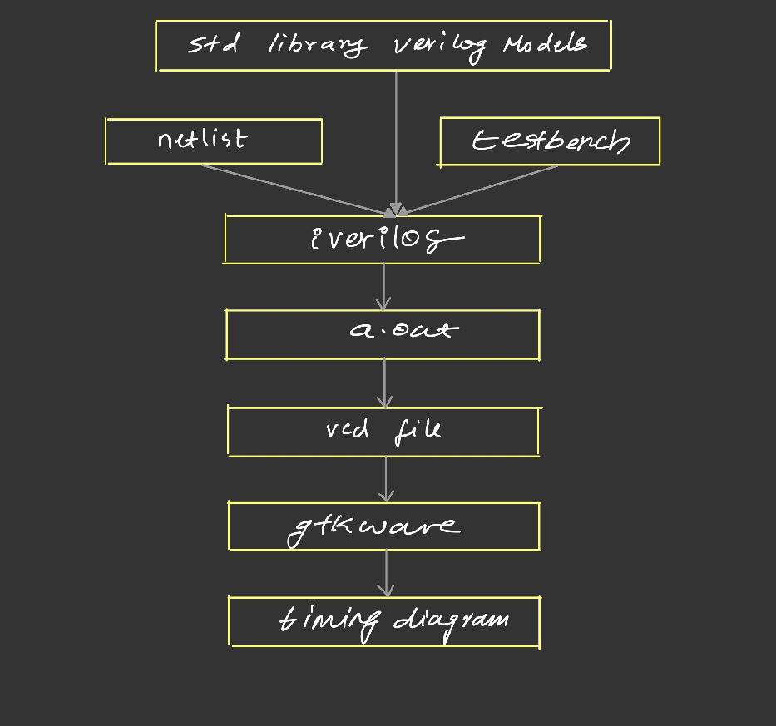
GLS with iverilog

Slide 12
Demo

Slide 13
Litex
A Framework that provides a convenient and efficient infrastructure to create FPGA Cores/SoCs
Migen
Buses including Wishbone and AXI
Easy to integrate VHDL/Verilog/SystemVerilog code in LiteX!
LiteX already supports various softcores CPUs including microwatt!!
Microwatt
  An opensource processor core implementing the Power ISA 3.0 instruction set

Slide 14
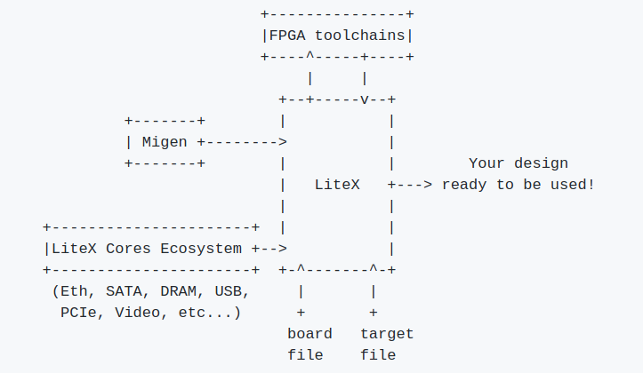
Typical LiteX design flow

Slide 15
Demo - Simulating a microwatt based SOC with Litex

Slide 16
Thankyou

